Slide 1
Report: Sensitivity Analysis of Radiation Distributions in W7X
P. Hacker

Slide 2
Background & Motivation
Plasma radiation
Data acquisition & calibrations
FIFO multi/single LOS feedback
Fast valve of thermal helium beam
Plasma feedback
We try to use the Bolometer to control the plasma based off of information on the radiation distribution.
adjust heat loads, investigate radiation regimes, maybe improved detachment
investigate radiation (scaling), i.e. importance of intrinsic/extrinsic impurities

Slide 3
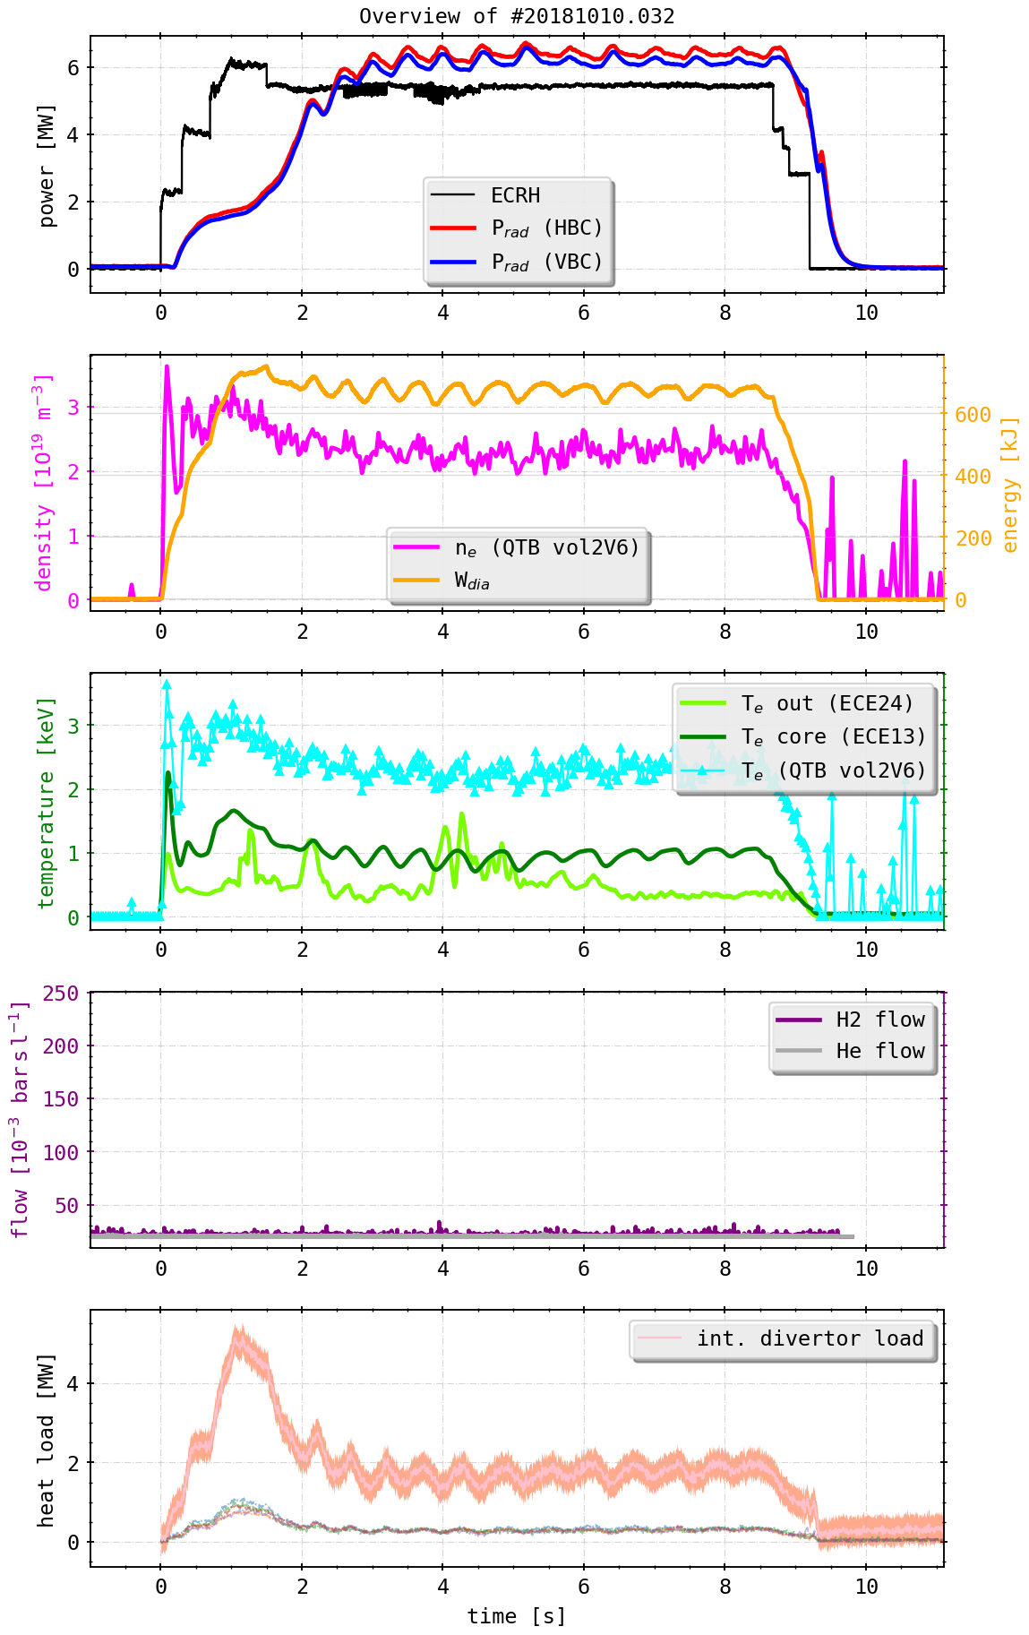
Background & Motivation
Plasma radiation
Data acquisition & calibrations
FIFO multi/single LOS feedback
Fast valve of thermal helium beam
Plasma feedback

Slide 4
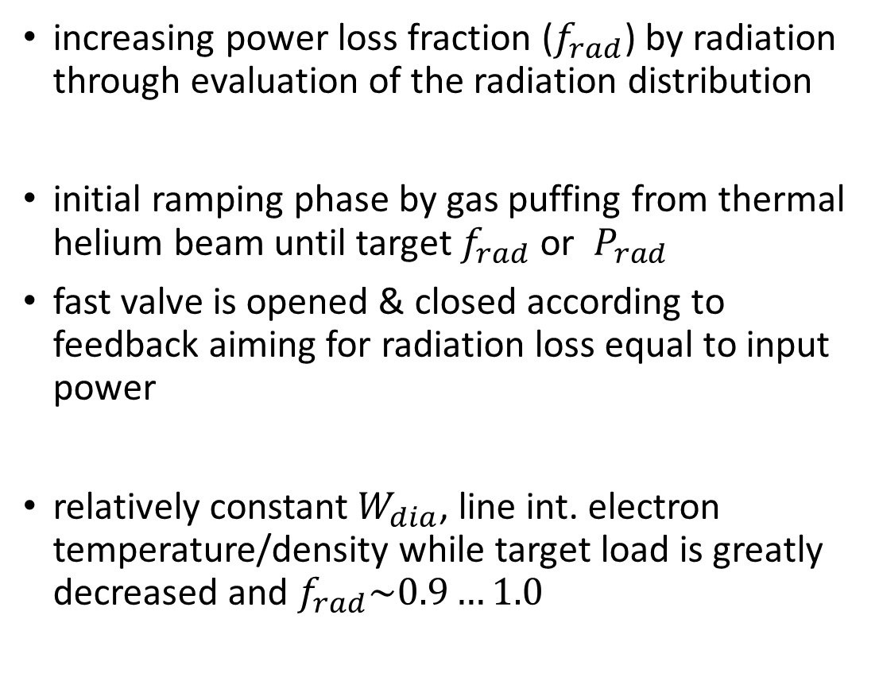
Background & Motivation
increasing power loss fraction ($f_{rad}$) by radiation through evaluation of the radiation distribution
initial ramping phase by gas puffing from thermal helium beam until target $f_{rad}$ or $P_{rad}$
fast valve is opened & closed according to feedback aiming for radiation loss equal to input power
relatively constant $W_{dia}$, line int. electron temperature/density while target load is greatly decreased and $f_{rad}\sim 0.9…1.0$

Slide 5
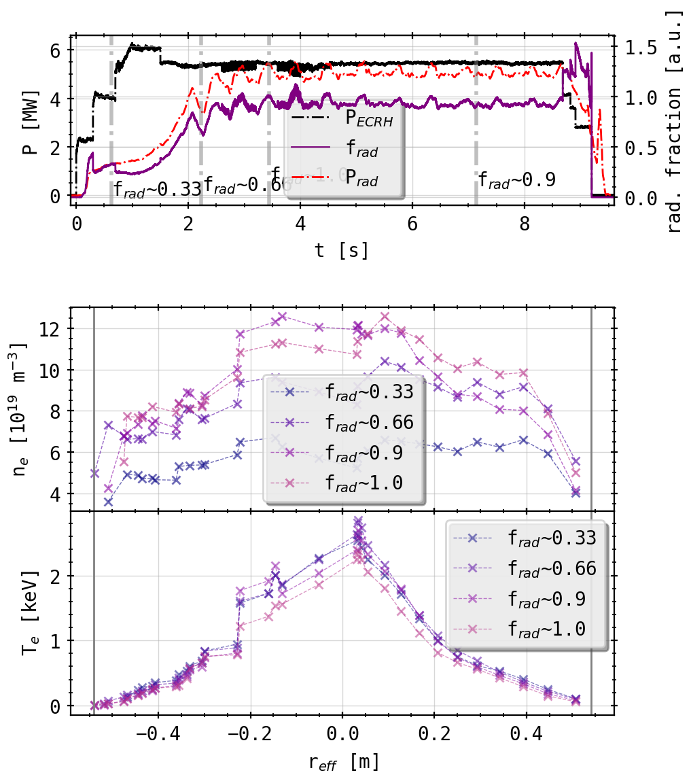
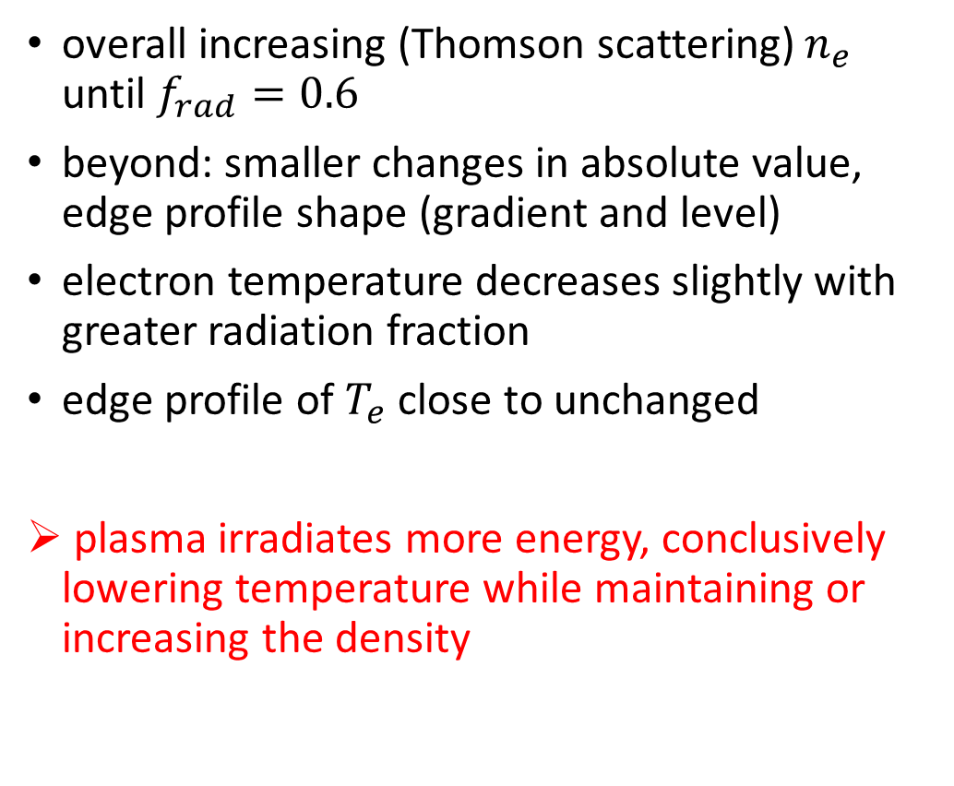
Background & Motivation
overall increasing (Thomson scattering) $n_{e}$ until $f_{rad}=0.6$
beyond: smaller changes in absolute value, edge profile shape (gradient and level)
electron temperature decreases slightly with greater radiation fraction
edge profile of $T_{e}$ close to unchanged
plasma irradiates more energy, conclusively lowering temperature while maintaining or increasing the density

Slide 6
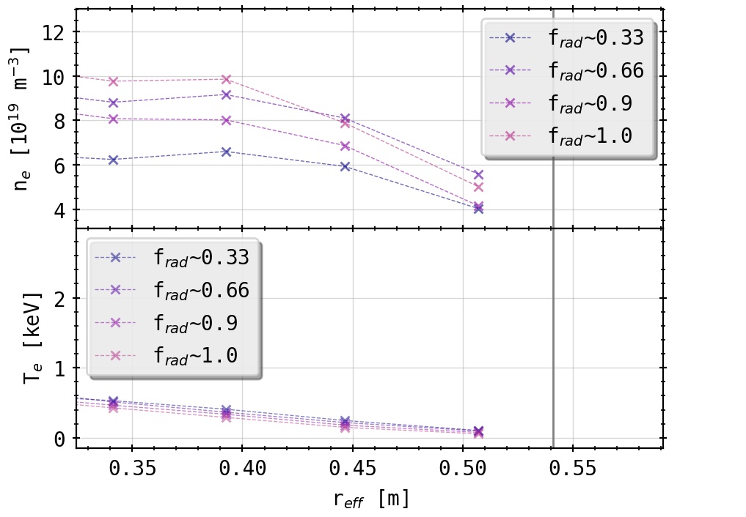
Background & Motivation
overall increasing (Thomson scattering) $n_{e}$ until $f_{rad}=0.6$
beyond: smaller changes in absolute value, edge profile shape (gradient and level)
electron temperature decreases slightly with greater radiation fraction
edge profile of $T_{e}$ close to unchanged
plasma irradiates more energy, conclusively lowering temperature while maintaining or increasing the density

Slide 7
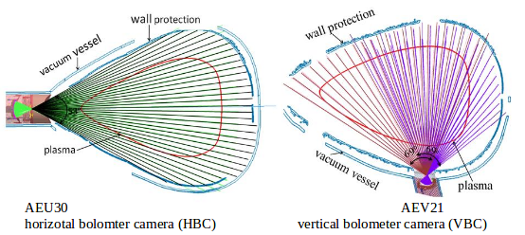
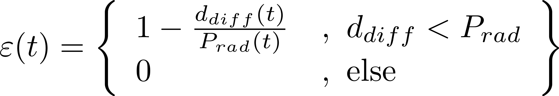
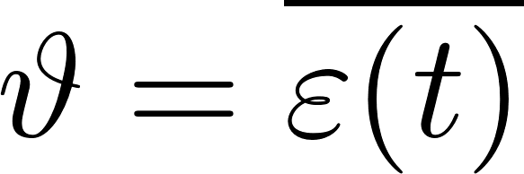
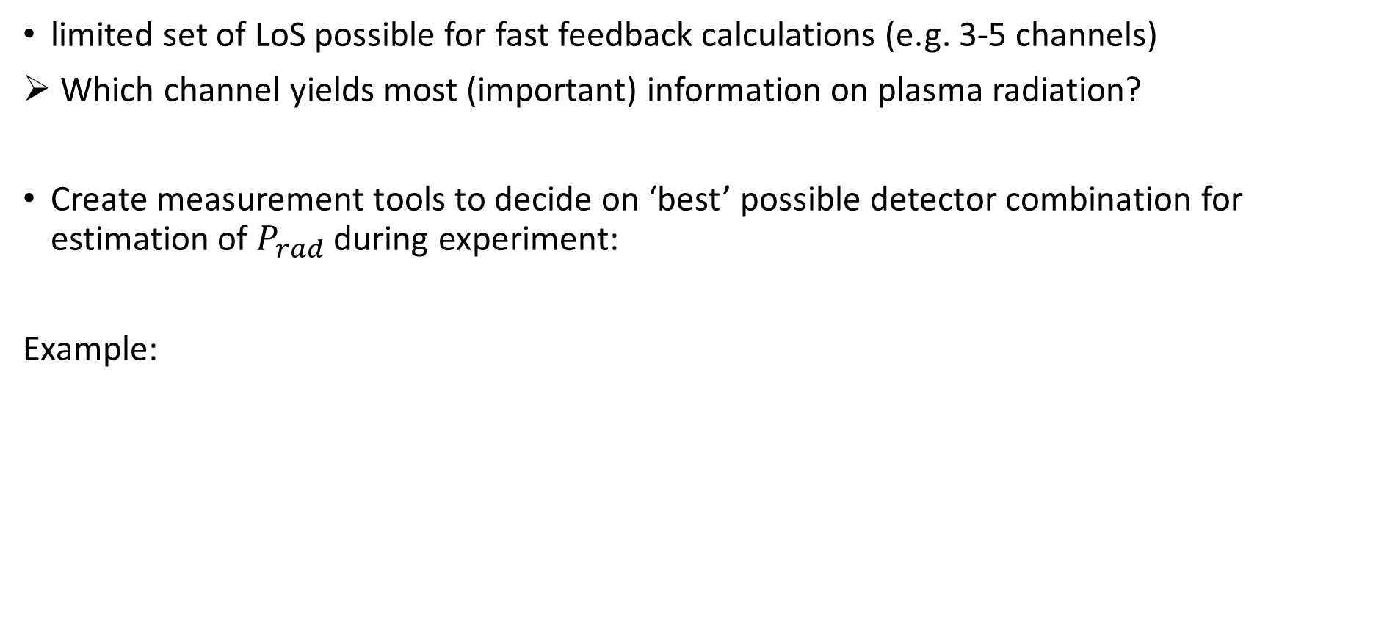
Feedback Evaluation
limited set of LoS possible for fast feedback calculations (e.g. 3-5 channels)
Which channel yields most (important) information on plasma radiation?
Create measurement tools to decide on ‘best’ possible detector combination for estimation of $P_{rad}$ during experiment:
Example:

Slide 8
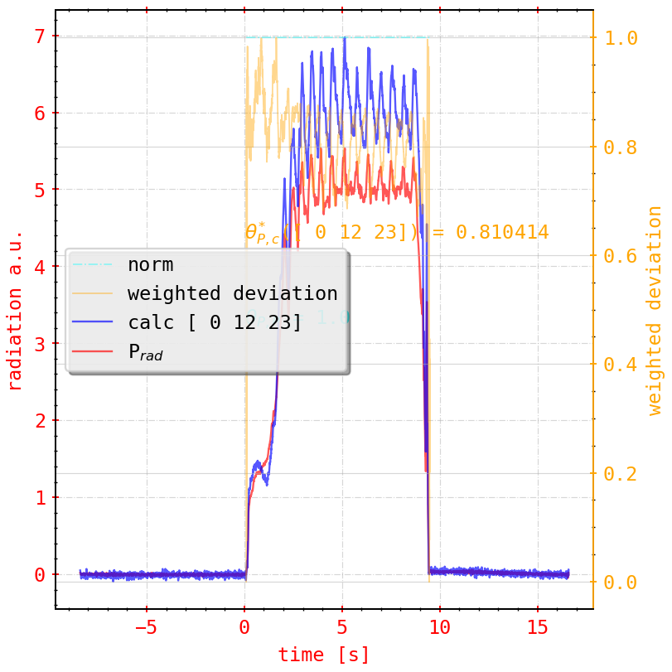
Feedback Evaluation
Example:
done for >1e4 combinations of cameras and channels
+ 8 different sensitivity metrics (e.g. self correlation, coherence, convolutional)
+ multiple experiments

Slide 9
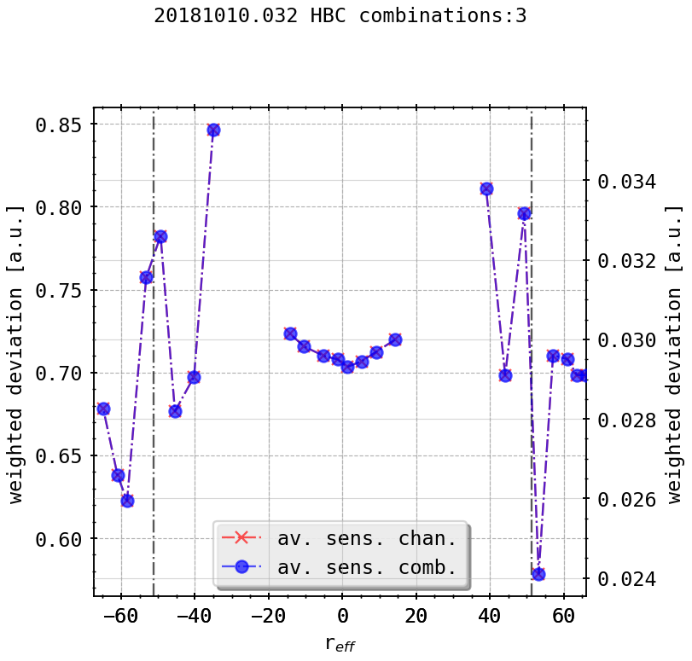
Feedback Evaluation
all evaluation methods and camera/subset combinations show roughly same behavior:
detectors viewing tangential to the LCFS/SOL or along island chains are capable of (at all times) representing >60% of the plasma radiation
lines of sight along the LCFS + slightly inwards are most sensitive to changes in the plasma radiation regime
a well picked subset of 3 detectors can reflect the total plasma radiation with up to 90% accuracy (!)

Slide 10
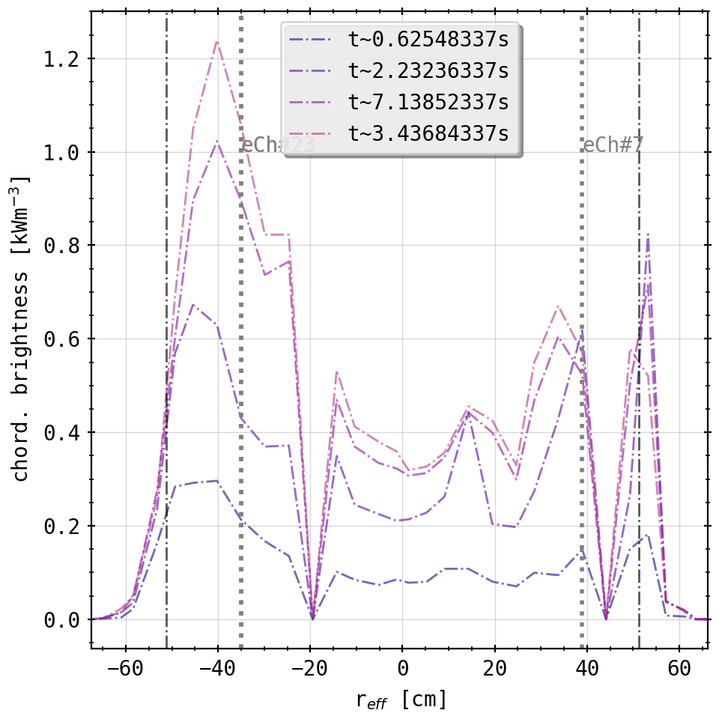
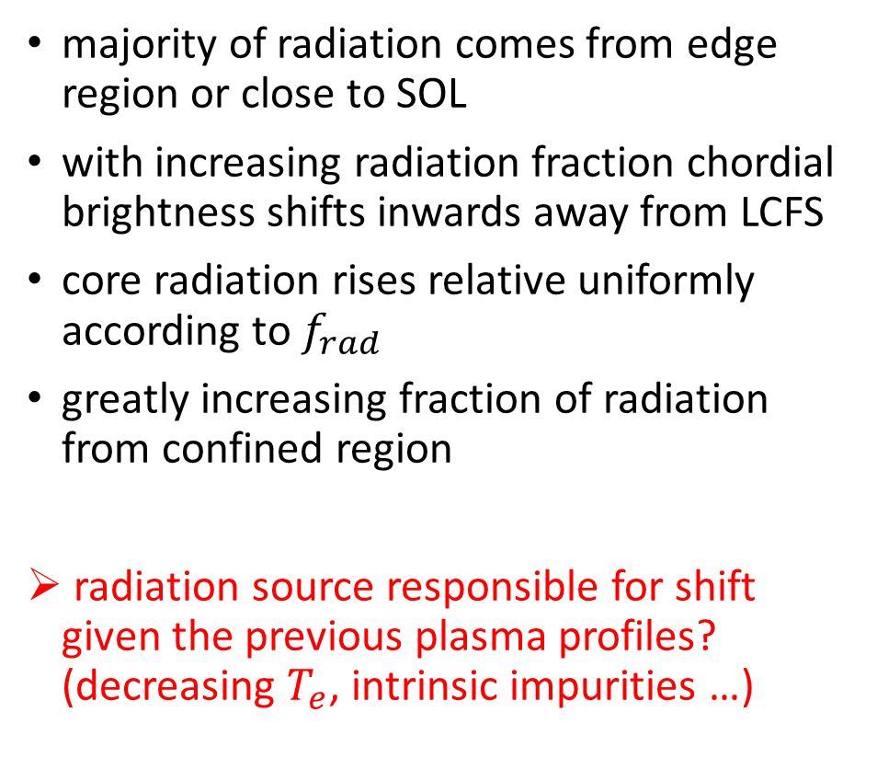
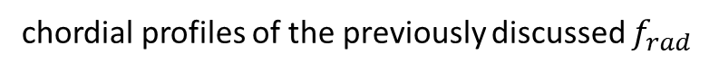
Feedback Evaluation
majority of radiation comes from edge region or close to SOL
with increasing radiation fraction chordial brightness shifts inwards away from LCFS
core radiation rises relative uniformly according to $f_{rad}$
greatly increasing fraction of radiation from confined region
radiation source responsible for shift given the previous plasma profiles? (decreasing $T_{e}$, intrinsic impurities …)
chordial profiles of the previously discussed $f_{rad}$

Slide 11
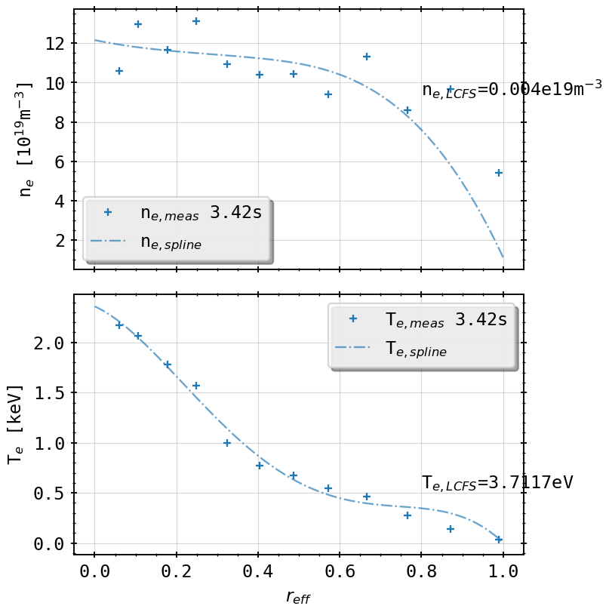
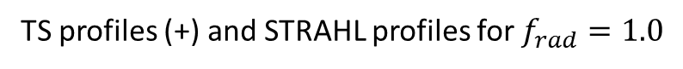
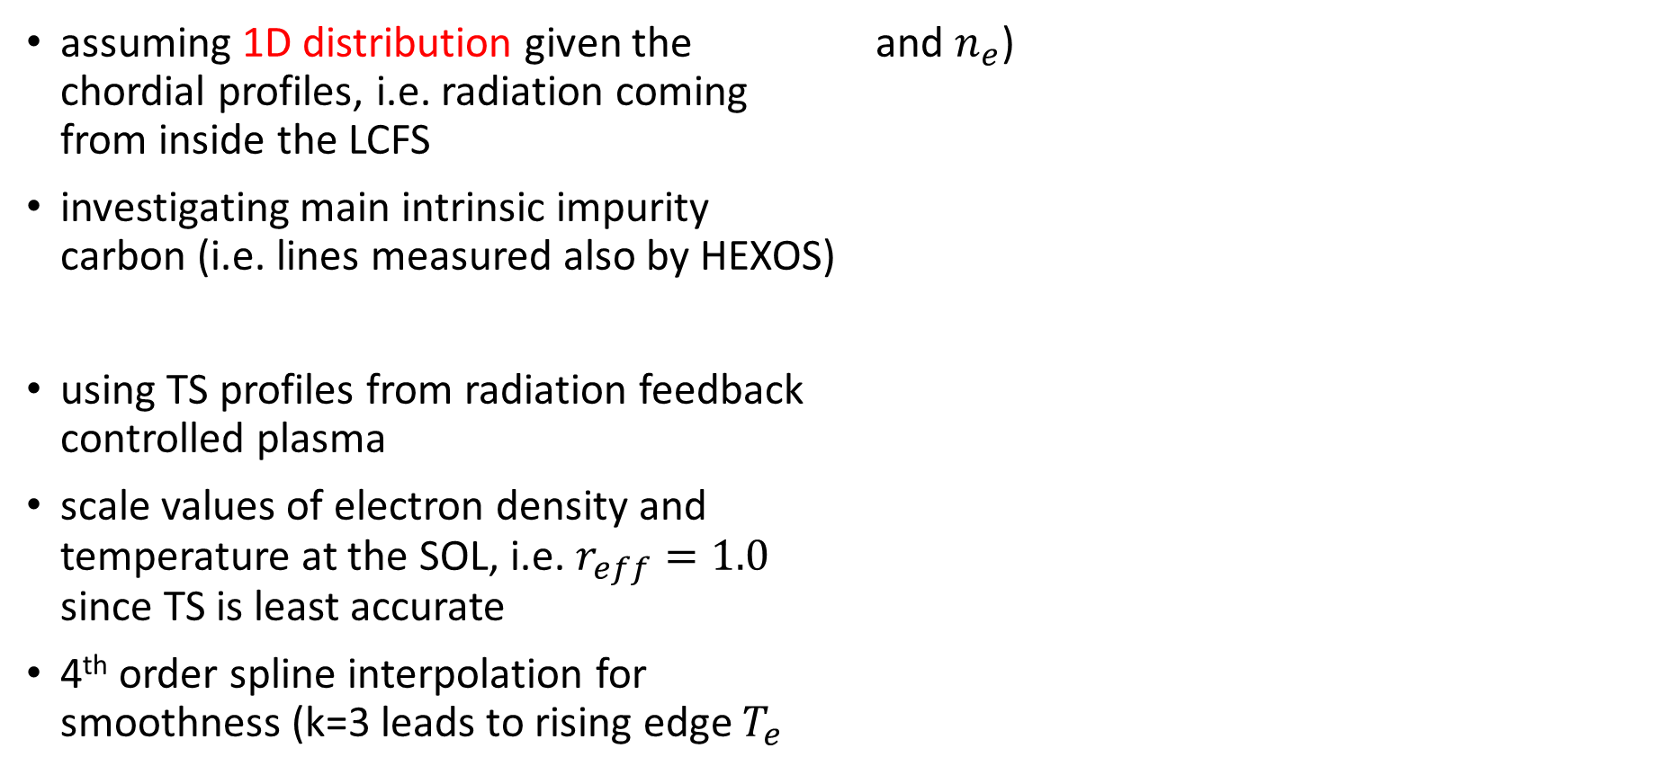
STRAHL Simulations of Carbon Radiation
assuming 1D distribution given the chordial profiles, i.e. radiation coming from inside the LCFS
investigating main intrinsic impurity carbon (i.e. lines measured also by HEXOS)
using TS profiles from radiation feedback controlled plasma
scale values of electron density and temperature at the SOL, i.e. $r_{eff}=1.0$ since TS is least accurate
4th order spline interpolation for smoothness (k=3 leads to rising edge $T_{e}$ and $n_{e}$)
TS profiles (+) and STRAHL profiles for $f_{rad}=1.0$

Slide 12
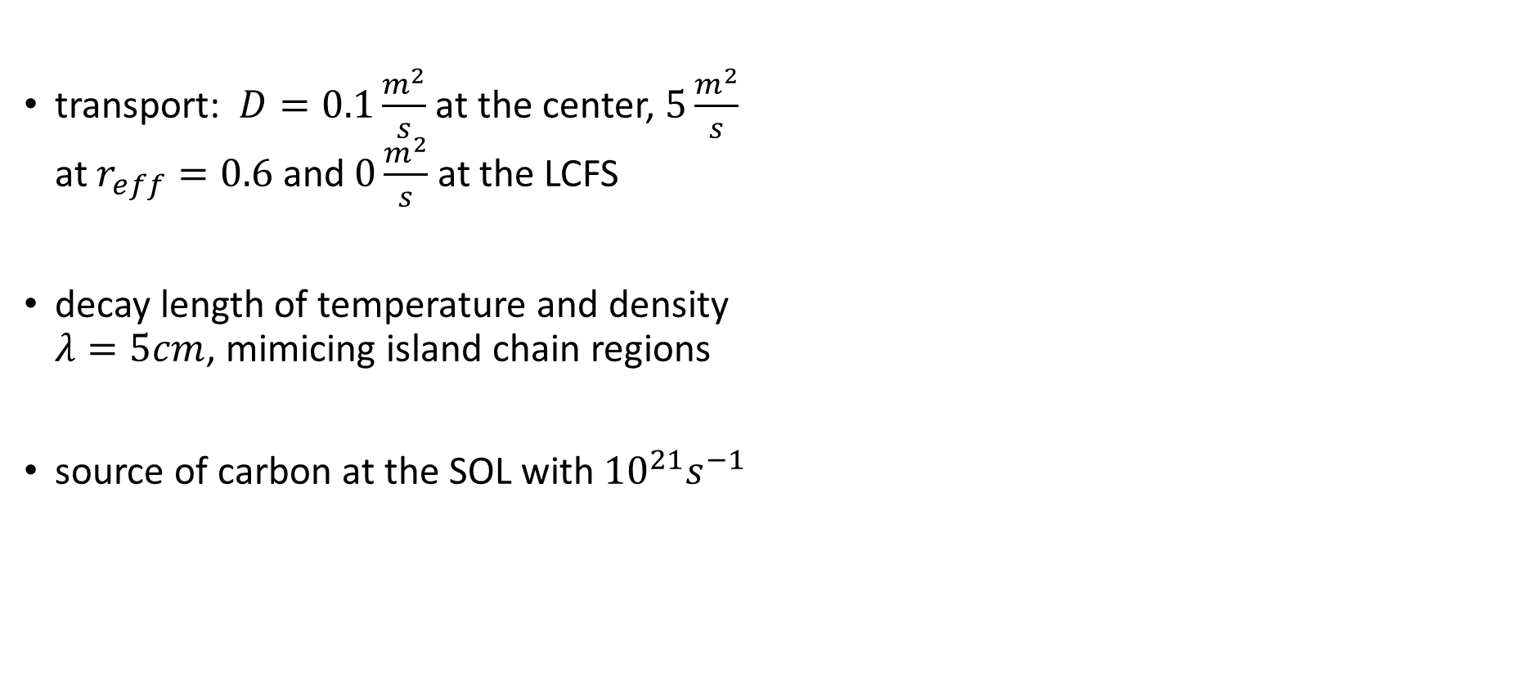
STRAHL Simulations of Carbon Radiation
transport: $D=0.1\frac{m^{2}}{s}$ at the center, $5\frac{m^{2}}{s}$ at $r_{ⅇff}=0.6$ and $0\frac{m^{2}}{s}$ at the LCFS
decay length of temperature and density $λ=5cm$, mimicing island chain regions
source of carbon at the SOL with${ 10}^{21}s^{−1}$
TS profiles (+) and STRAHL profiles for $f_{rad}=1.0$

Slide 13
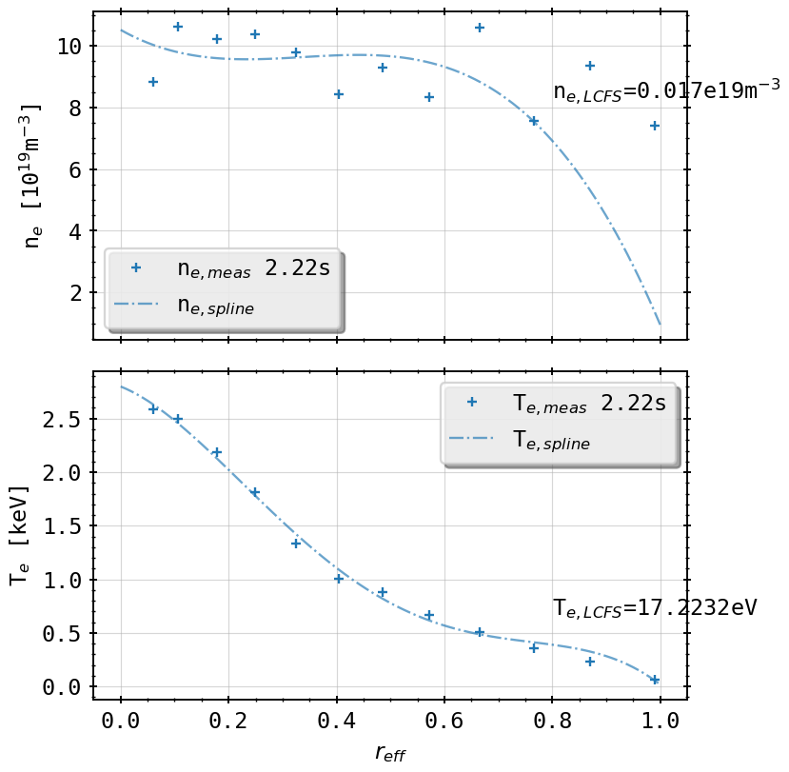
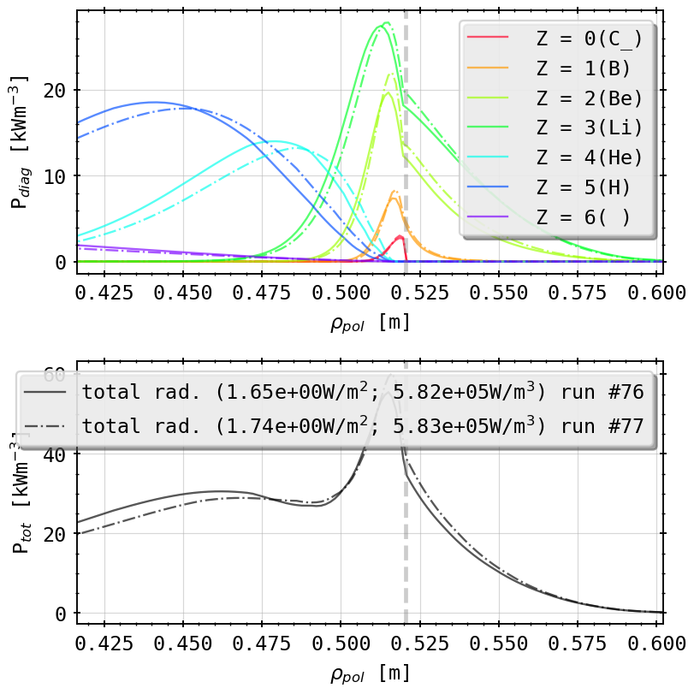
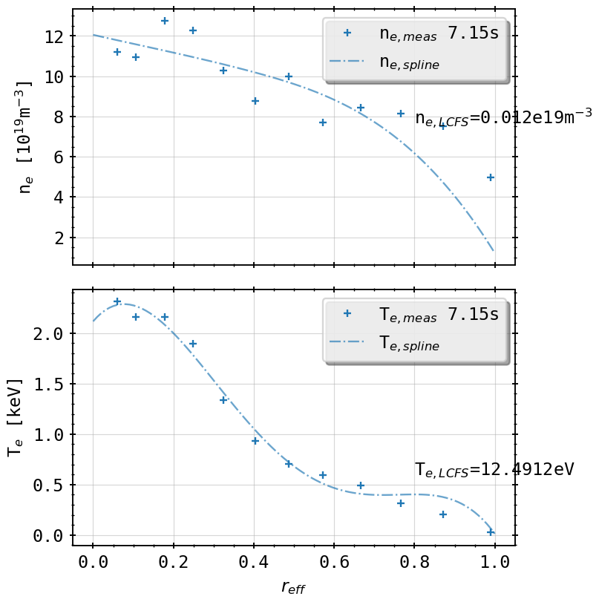
STRAHL Simulations: 60% v 90%
TS profiles (+) and STRAHL profiles for $f_{rad}=0.6, 0.9$
coronal equilib. line radiation profiles for $f_{rad}=0.6, 0.9$

Slide 14
STRAHL Simulations: 60% v 90%
minimal inward shift of all ionization stages inconclusive for Bolometer, since spatial resolution is 5cm
slight change of radiation fraction between core and SOL
radiation peak inside LCFS
coronal equilib. line radiation profiles for $f_{rad}=0.6, 0.9$

Slide 15
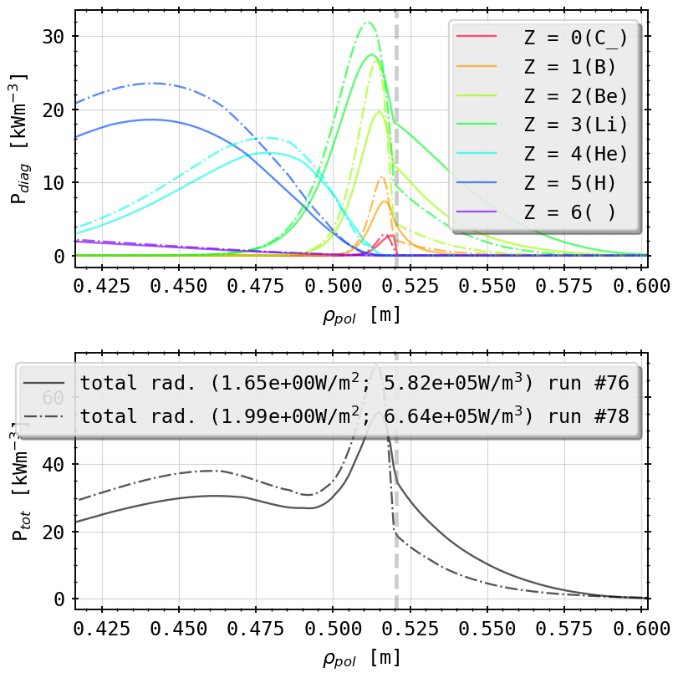
STRAHL Simulations: 60% v 100%
TS profiles (+) and STRAHL profiles for $f_{rad}=0.6, 1.0$
coronal equilib. line radiation profiles for $f_{rad}=0.6, 1.0$

Slide 16
STRAHL Simulations: 60% v 100%
very small temperature at LCFS (3eV) for 100% of irradiated power
insignificant shift in position of ionization peaks
trend between SOL and core radiation changes >> strong core radiating carbon population
volume integrated radiation (for 30sqm of plasma volume) roughly matches experimental level
coronal equilib. line radiation profiles for $f_{rad}=0.6, 1.0$

Slide 17

STRAHL Simulations: 90% v 100%
TS profiles (+) and STRAHL profiles for $f_{rad}=0.9, 1.0$
coronal equilib. line radiation profiles for $f_{rad}=0.9, 1.0$

Slide 18
STRAHL Simulations: 90% v 100%
measurable spatial shift, especially now in Be- and Li-like ion radiation peaks
transition from bright to dark SOL from 90% to 100% of radiation power loss
possible means for radiation regimes in detachment
intrinsic impurity C main radiation source? (oxygen levels <1/3rd for same scenario)
coronal equilib. line radiation profiles for $f_{rad}=0.9, 1.0$

Slide 19
Future Investigation
directly compare line integrated STRAHL results for lines of sight geometry with chordial profiles
measure SOL and core radiation in both STRAHL and Bolometer data
extend simulation space to 2D inversion with MFR(Minimum Fisher Regularization)

